Slide 1
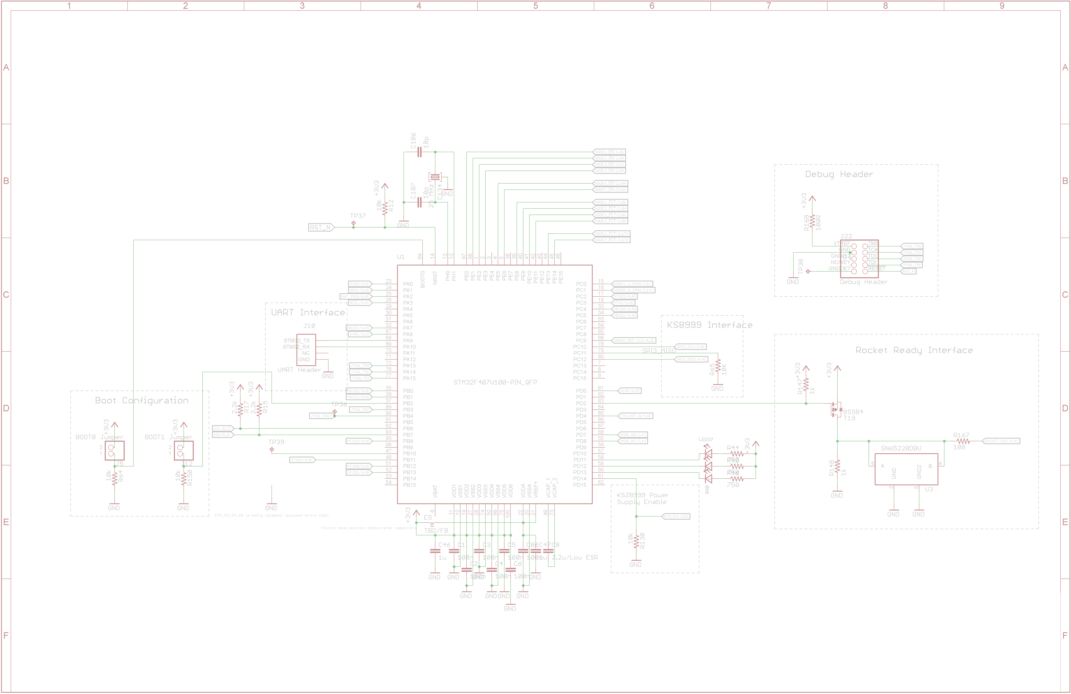
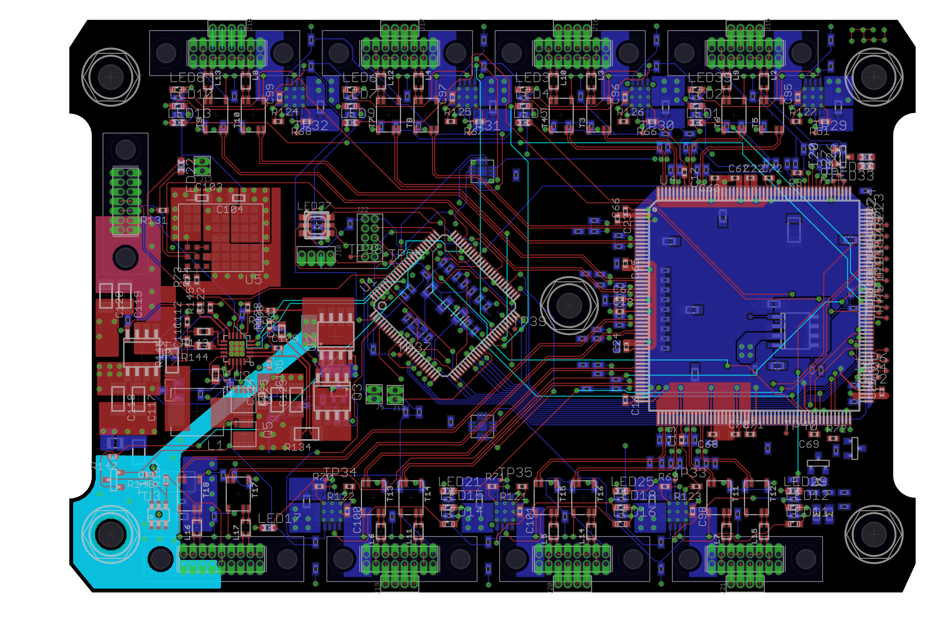
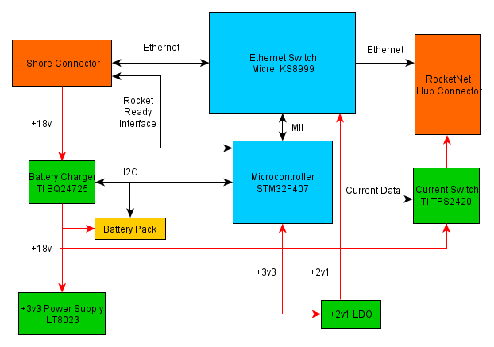

PSAS RocketNet Hub || Capstone 2012-2013
Sponsor---Andrew Greenberg | Members--Jackson Pugh---Michael Woodruff---JJ Hartley | Faculty Advisor---Dr. Richard Campbell
Overview
The capstone sponsor, Portland State Aerospace Society (PSAS) designs, builds, and launches high power rockets. Their 2013 Capstone project is a power management and communications solution for use in both their current and next generation launch vehicles. To accommodate the size and weight restrictions imposed by the physical characteristic of the current launch vehicle, the decision was made to pursue a highly integrated solution which would provide for all the power management functions as well as provide low latency communication between all of the electronic subsystems used in-flight.
Design
Data/Ethernet:
The Micrel KS8999, while the largest IC on the board, contains a 9-port Ethernet switch. It was picked to handle the main data communication because…
Microcontroller:
STMicroelectronics STM32F407 was selected to bootstrap the on-board peripherals and monitor the status in-flight…
Power Supply Regulation:
Linear Technology LTM8023 SPS was chosen…
Micrel 2V1 LDO was chosen…
Current Protection:
Power protection is handled by TI TPS2420 current switches.
Requirements
The board should contain the following:
Support at least seven independent nodes
High reliability and fail-safe design
Provide low latency inter-node communications using a common protocol
Independent power management for each node in-flight and battery management pre-flight
High efficiency switching power regulation from high voltage battery pack and low voltage logic
Low-power consumption when in standby mode
High-Level Block Diagram
RocketNet Power and Data Distribution Board Layout
Department of Electrical and Computer Engineering
†Background image is a screenshot of the STM32 microcontroller schematic in Eaglecad

